Slide 1

Agent Hospital

Slide 2
Simulacrum-based Evolutionary Agent Learning
Simulacrum Construction
Agent Evolution
Data: disease, symptoms, results, disease progression
LLMs generate medical data guided by medical knowledge bases
Storing and retrieving successful cases
Gaining experience from unsuccessful cases

Slide 3
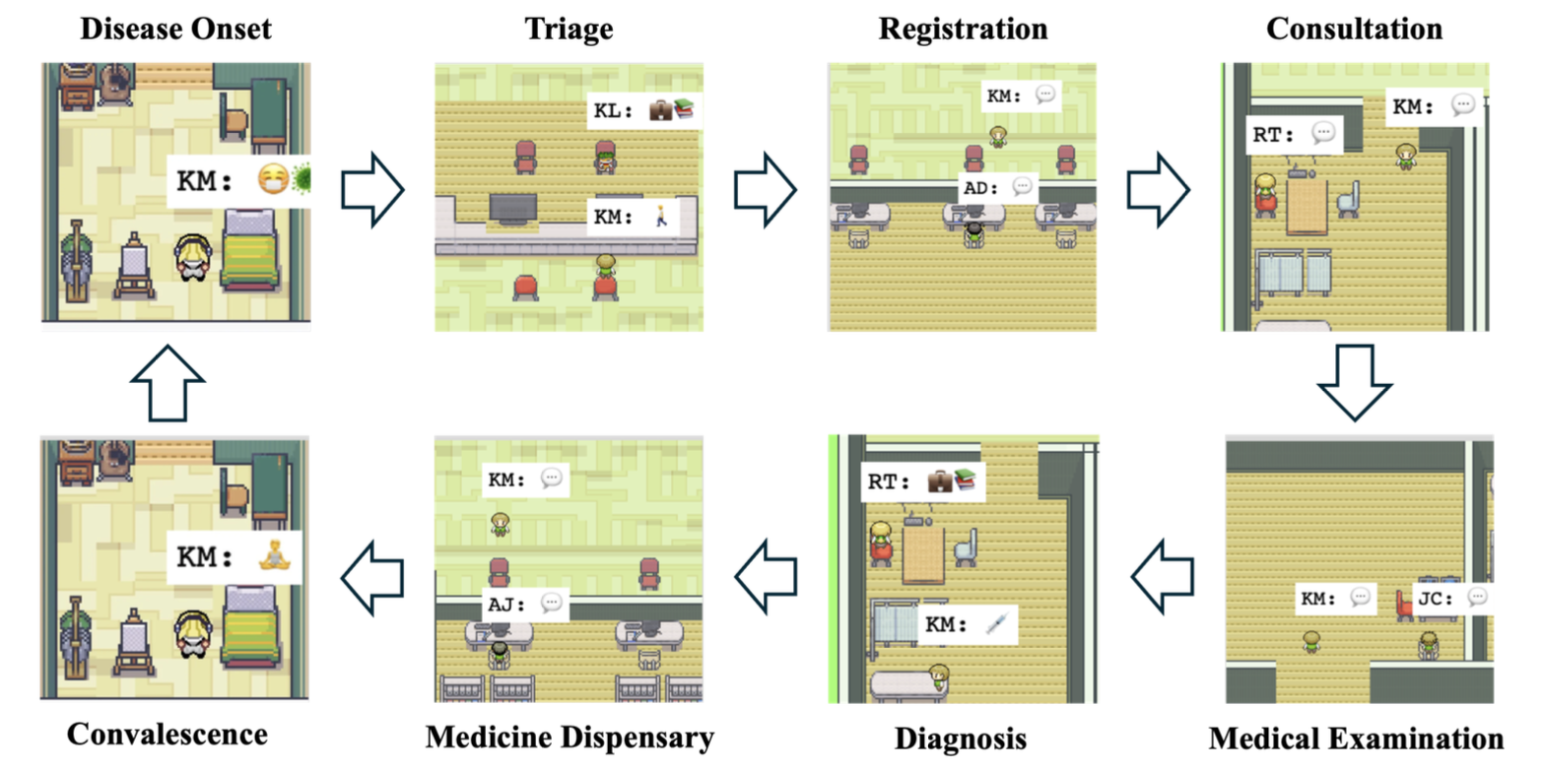
Simulacrum Construction
16 functional areas, whole closed cycle of patients’ treatment
triage station, registration desk, waiting area, consultation rooms, examination room, pharmacy, and follow-up room
Patient Agents
✓ Medical history
hypertension
Medical Professional Agents
✓ Additional info about skills
and duties
8 main types of events
Notes:
Simulacrum construction agent is the only one? If not, what are the other approaches.
How to define from triage -> 8 events -> represent the whole workflow? If not, what might be the extra or additional

Slide 4
Agent Evolution
Patient Agent Generation
Doctor Agent Evolution
basic information
→ possible age / gender / …
medical history
list of symptoms
medical examination
Medical case base e.g. KM with hypertension and herpes
Experience base JH with similar history
both grow with the increase number of patients
Notes:
Pros and cons, in agent evolution in that simple architecture
Find ways to improve
Major : take roles,
Purpose better methodology
Agent evolution is the weakest point -

Slide 5
Scaling Laws in Evolution
Virtual
Real
Medical examination selection
32 medical departments
Diagnosis
More than 300 diseases
Treatment plan recommendation
Accuracy of doctor agents
↓
Number of patients treated
without using labelled training data

Slide 6
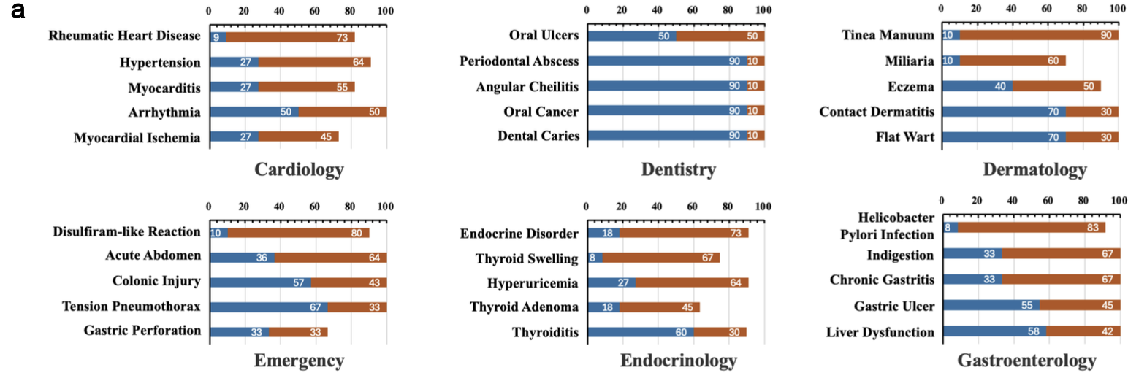
Notes:
red part is the increase percentage
therefore, blue = gpt 3.5 used.
blue + red = final results after improvement (gpt-4o)
Integrate – where do the departments,
For each specialty, concerns of the comprehensiveness
Cannot deal with challenging tasks, rare diseases, -> potential improvement, stronger agentic system in 1 specialty
Cases that require more reasoning

Slide 7
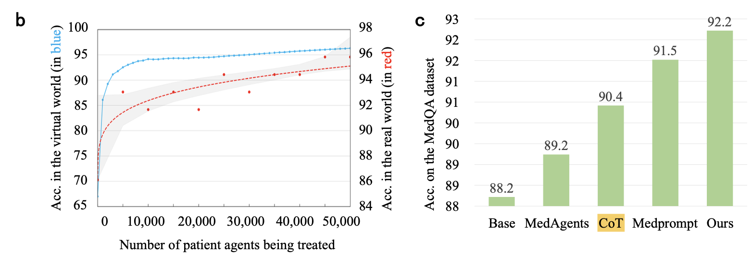

Slide 8
Related Work
LLM-powered Medical Agents
Self-Improving LLM-powered Agents
Simulacrum Construction for LLM-powered Agents

